Slide 1
Registers and Counters
CSE 2203: Digital Technique

Slide 2
What is a Register?
A Register is a collection of flip-flops with some common function or characteristic
  Control signals - common clock, clear, load, etc.
  Function - part of multi-bit storage, counter, or shift register
At a minimum, we must be able to:
  Observe the stored binary value
  Change the stored binary value

Slide 3
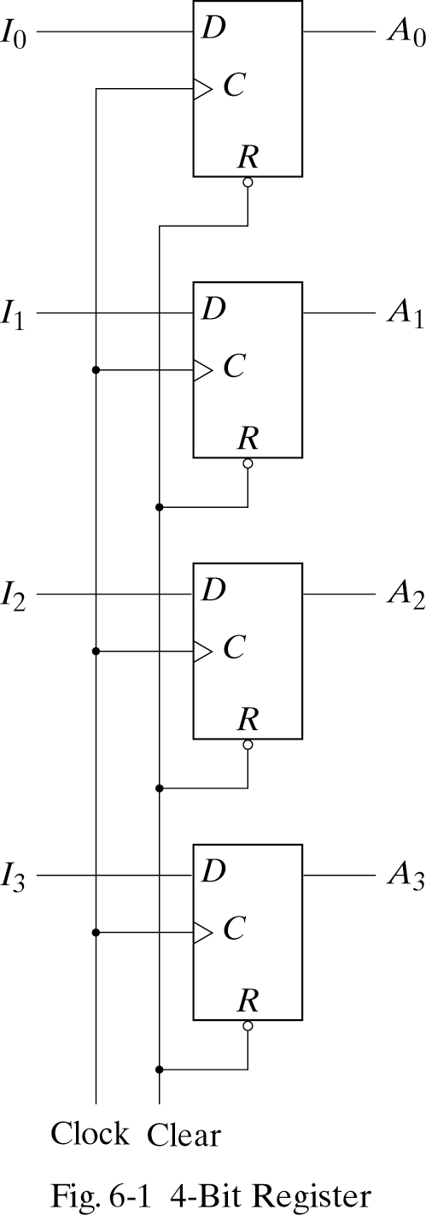
What is a Register?
Register: Group of Flip-Flops
Example: D Flip-Flops
Holds a Word (Nibble) of Data
Loads in Parallel on Clock Transition
Asynchronous Clear (Reset)

Slide 4
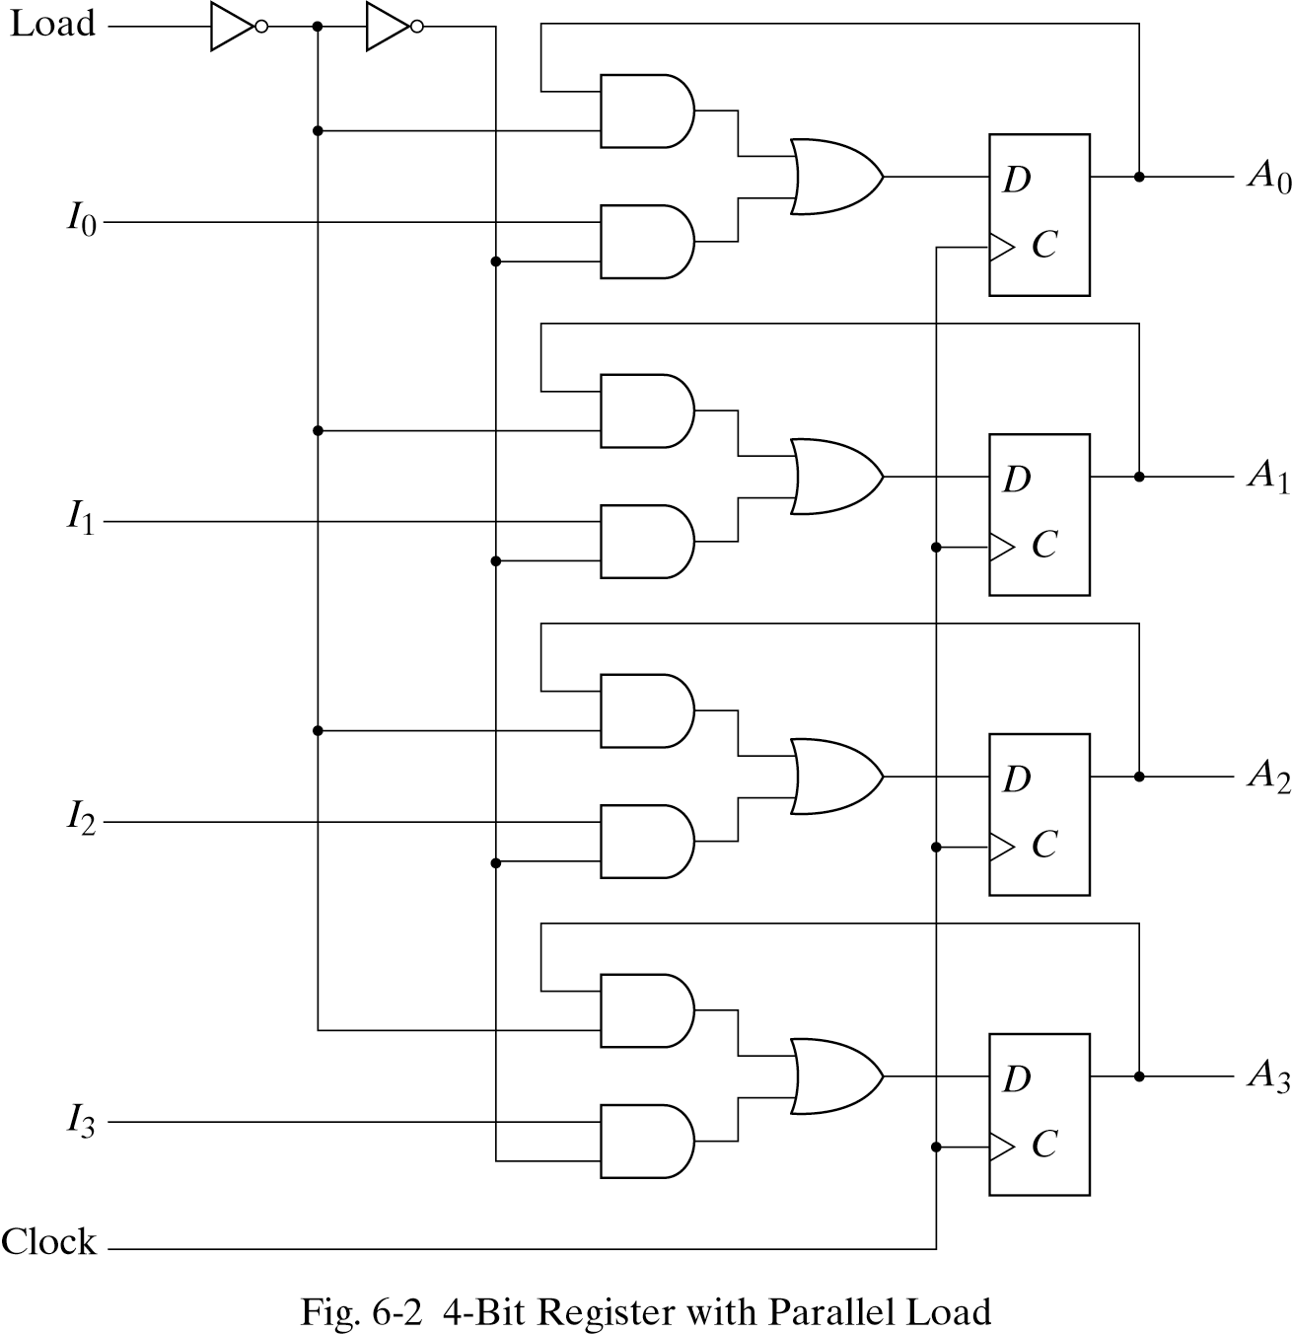
Load Data to a Register
Load Control = 1
  New data loaded
  on next positive
  clock edge
Load Control = 0
  Old data reloaded
  on next positive
  clock edge

Slide 5
Data Transfer
Information is moved from register to register by:
  Parallel data transfer
  Serial data transfer
For example:
  Older printers use parallel data transfer
  USB devices use serial data transfer

Slide 6

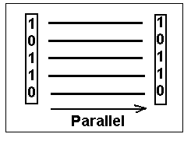
Serial vs Parallel
Serial communications is defined as
  Transfer a binary number as a sequence of binary digits, one after another, through one data line.
Parallel communications:
Provides a binary number through multiple data lines at the same time.

Slide 7
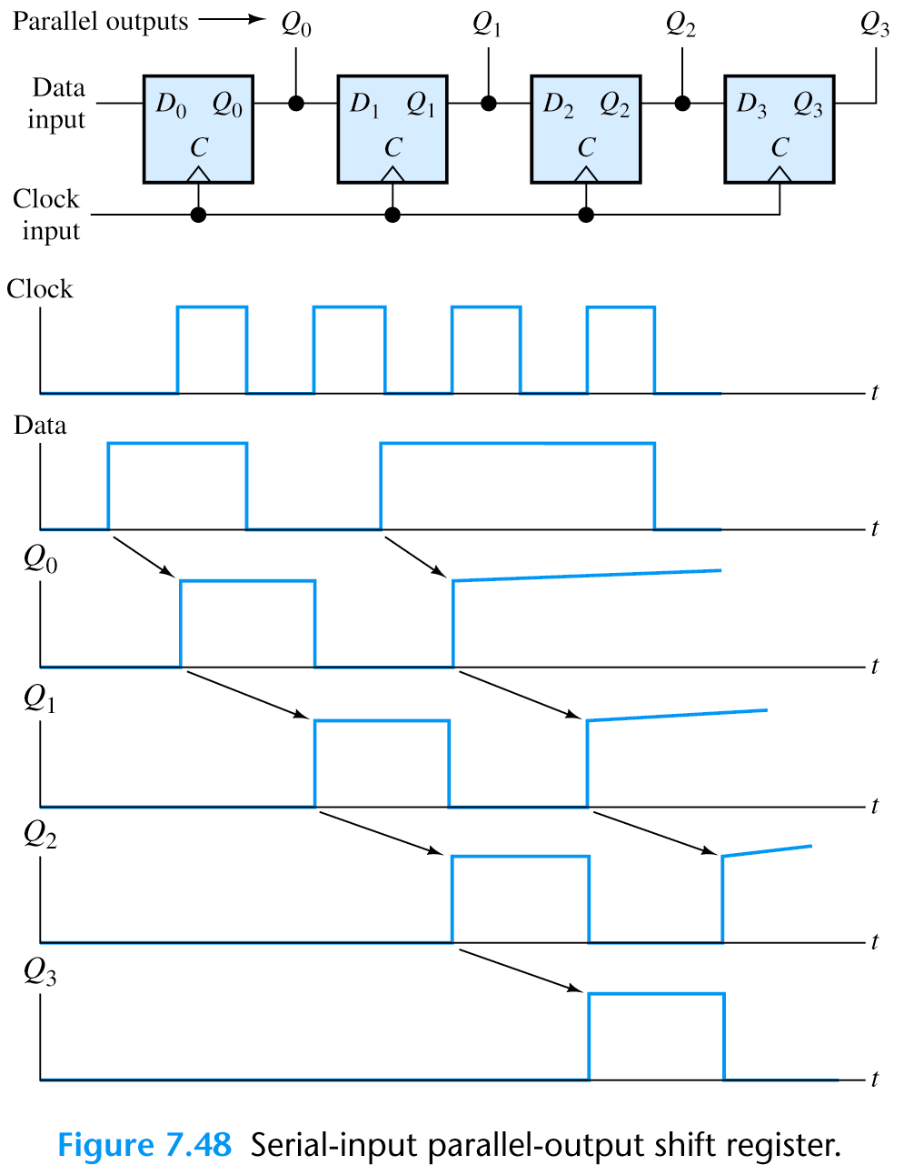
Serial Data Transfer
a.

Slide 8
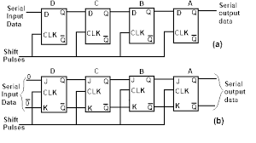
Serial Data Transfer and Shift Register
Cascade chain of Flip-Flops
Bits travel on Clock edges
Serial in – Serial out, can also have parallel load / read
Require N clock pulses to transfer N bits of data.
Register 1 |  |  |  | Register 2
1 | 0 | 1 | 1 | 0 | 0 | 0 | 0 | Before pulse
0 | 1 | 0 | 1 | 1 | 0 | 0 | 0 | After 1st pulse
0 | 0 | 1 | 0 | 1 | 1 | 0 | 0 | After 2nd pulse
0 | 0 | 0 | 1 | 0 | 1 | 1 | 0 | After 3rd pulse
0 | 0 | 0 | 0 | 1 | 0 | 1 | 1 | After 4th pulse

Slide 9
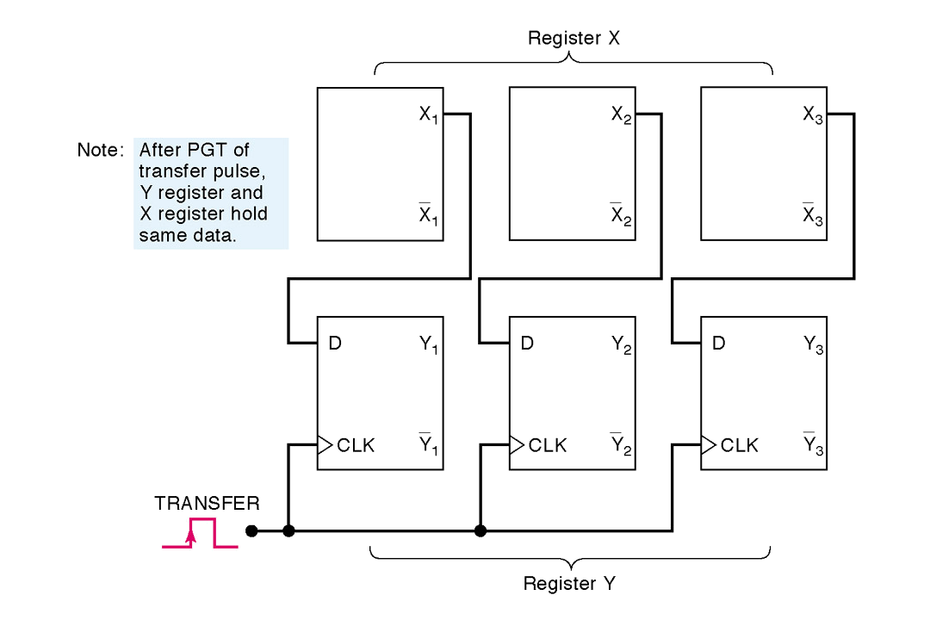
Parallel Data Transfer
All data transfers on rising clock edge
Data transferred into register Y from X

Slide 10
Serial vs Parallel
Parallel transfer is faster than serial transfer and obviously N times faster for N lines of connections.
Parallel transfer need:
More interconnections
Limited to the number of bits and gets critical when large number of bits need to be transferred.
Choice of serial/parallel transfer depends on the requirements of the system.

Slide 11




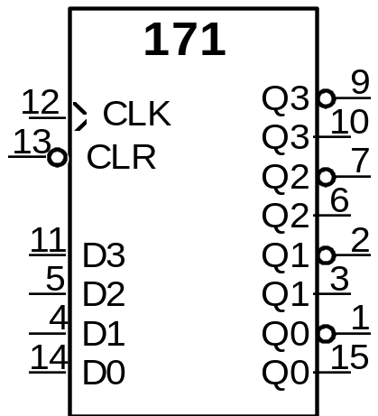
Kinds of Registers and Counters
Storage Register
V+
Group of storage elements read/written as a unit
CLR
4-bit register constructed from 4 D FFs
Shared clock and clear lines
D3
D Q
C Q
Q3
Q3F
Schematic Shape
D2
D Q
C Q
Q2
Q2F
D1
D Q
C Q
Q1
Q1F
D0
D Q
C Q
Q0
TTL 74171 Quad D-type FF with Clear
(Small numbers represent pin #D on package)
CLK
Q0F

Slide 12
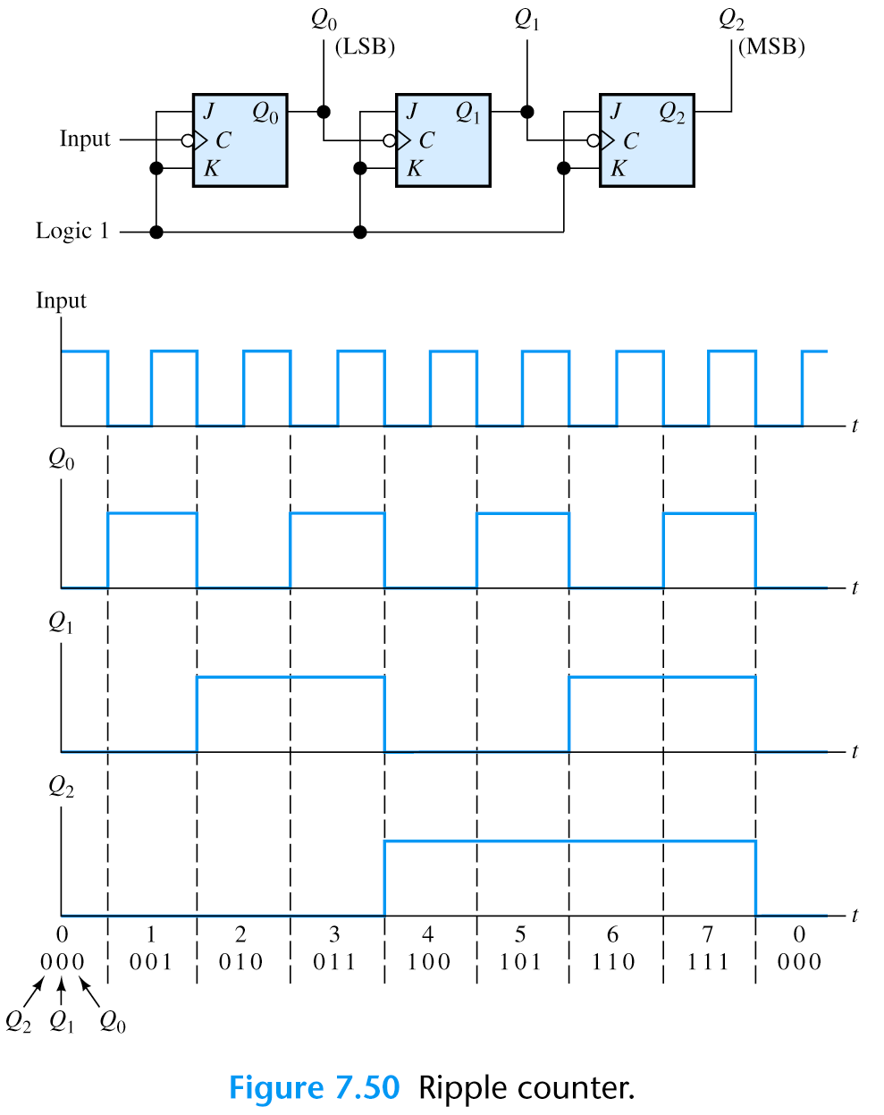
Kinds of Registers and Counters
J=1
K=1

Slide 13
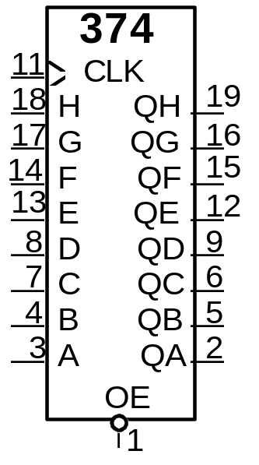
Kinds of Registers and Counters
Input/Output Variations
Selective Load Capability
Tri-state or Open Collector Outputs
True and Complementary Outputs
377
11
CLK
1
EN
18
D7
Q7
19
17
D6
Q6
16
14
D5
Q5
15
13
D4
Q4
12
8
D3
Q3
9
7
D2
Q2
6
4
D1
Q1
5
3
D0
Q0
2
74377 Octal D-type FFs
with input enable
74374 Octal D-type FFs
with output enable
EN enabled low and lo-to-hi clock transition to load new data into register
OE asserted low presents FF state to output pins; otherwise
high impedence
CSE 307: Digital Technique
Page <number>

Slide 14
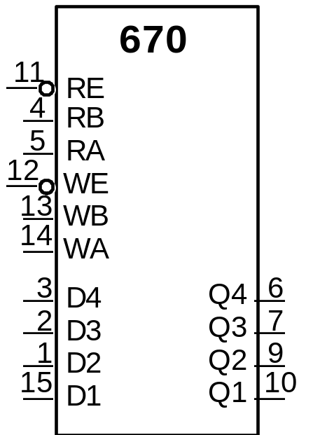
Kinds of Registers and Counters
Register Files
Two dimensional array of flip-flops
Address used as index to a particular word
Word contents read or written
Separate Read and Write Enables
Separate Read and Write Address
Data Input, Q Outputs
Contains 16 D-ffs, organized as
four rows (words) of four elements (bits)
74670 4x4 Register File with
Tri-state Outputs
CSE 307: Digital Technique
Page <number>

Slide 15
Kinds of Registers and Counters
Shift Registers
Storage + ability to circulate data among storage elements
Vcc
Q
Q
Q
Q
Reset
Shift Direction
1
2
3
4
1
0
0
0
Shift
J Q
K Q
Q₁
J Q
K Q
Q₂
J Q
K Q
Q₃
J Q
K Q
Q₄
0
1
0
0
CLK
CLK
CLK
CLK
Shift
0
0
1
0
Shift
Shift
0
0
0
1
Reset
Vcc
Shift from left storage
element to right neighbor
on every lo-to-hi transition
on shift signal
Wrap around from rightmost
element to leftmost element
CSE 307: Digital Technique
Page <number>

Slide 16
Parallel Data Transfer
Parallel data transfer moves data from one register
to another at one time
Reg. A
Reg. B
clock
When clock occurs, all bits of A are copied to B
CSE 307: Digital Technique
Page <number>

Slide 17
Serial Data Transfer
Serial transfer moves data bits from A to B one bit per clock
Rx and Tx have single wire between the two.
For ‘n’ bit registers, it takes ‘n’ clocks for data move
1 bit
signal
Reg. A
Reg. B
clock
Usual implementation is with a shift register.
CSE 307: Digital Technique
Page <number>

Slide 18
Serial Data Transfer
Typical serial transfer is a multi-step process
  Load transmit shift register with data to send
  Shift data bit by bit from transmit to receive SR
  Transfer received data to other registers
The transmit SR must have parallel load
  AKA parallel to serial shift register
The receive SR must have parallel outputs
  AKA serial to parallel shift register
Other control/timing signals usually needed
CSE 307: Digital Technique
Page <number>

Slide 19

Serial Data Transfer
Parallel
Transmit
Data
‘n’ bits
load
1 bit signal
(serial data)
Reg. A (P to S)
Reg. B (S to P)
‘n’ bits
clock
Parallel
Receive
Data
CSE 307: Digital Technique
Page <number>

Slide 20
Serial Data Transfer
Serial data transfer used where data rate is relatively slow and/or parallel bit transfer channels are expensive
  PC serial port and USB interfaces
  wireless/fiber optic data transmissions
    Cell phones
    Wireless networks
    Satellite telephone/TV
    Mars rover/orbiter communications
CSE 307: Digital Technique
Page <number>

Slide 21




























Typical Multi-Function Shift Register
Shift Register I/O
Serial vs. Parallel Inputs
Serial vs. Parallel Outputs
Shift Direction: Left vs. Right
S1
S0
LSI
A
B
C
D
RSI
CLK
CLR
Serial Inputs: LSI, RSI
Parallel Inputs: D, C, B, A
Parallel Outputs: QD, QC, QB, QA
Clear Signal
Positive Edge Triggered Devices
S1,S0 determine the shift function
S1 = 1, S0 = 1: Load on rising clk edge
synchronous load
S1 = 1, S0 = 0: shift left on rising clk edge
LSI replaces element D
S1 = 0, S0 = 1: shift right on rising clk edge
RSI replaces element A
S1 = 0, S0 = 0: hold state
Multiplexing logic on input to each FF!
QA
QB
QC
QD
74194 4-bit Universal
Shift Register
Shifters well suited for serial-to-parallel conversions,
such as terminal to computer communications
CSE 307: Digital Technique
Page <number>

Slide 22
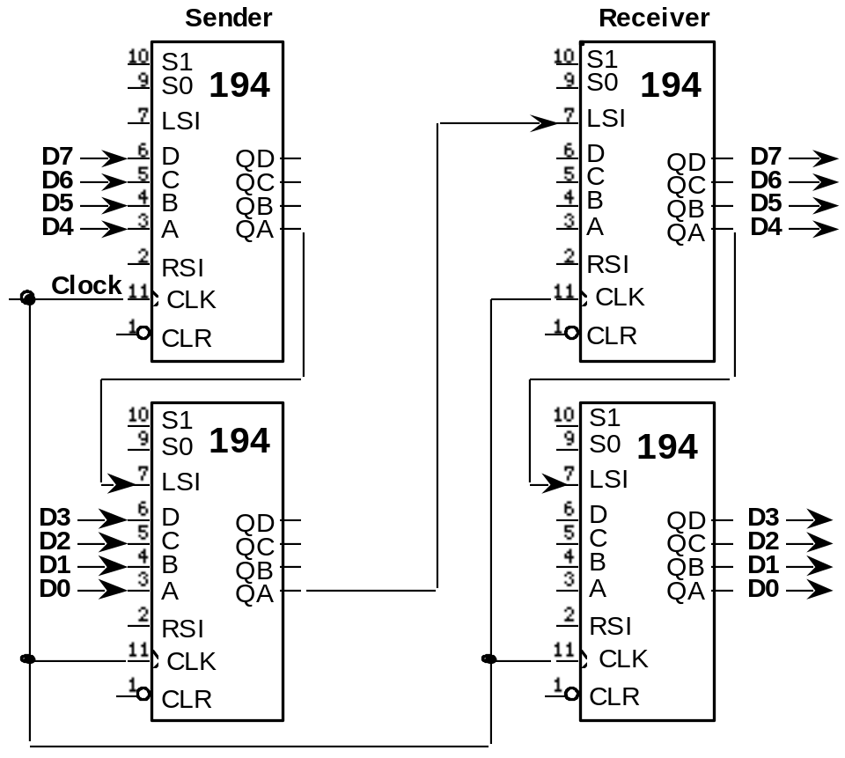
Serial Transfer with Shift Registers
Shift Register Application: Parallel to Serial Conversion
Parallel
Inputs
Parallel
Outputs
Serial
transmission
CSE 307: Digital Technique
Page <number>

Slide 23
Kinds of Registers and Counters
Counters
Proceed through a well-defined sequence of states in response to the count signal.
3 Bit Up-counter: 000, 001, 010, 011, 100, 101, 110, 111, 000, ...
3 Bit Down-counter: 111, 110, 101, 100, 011, 010, 001, 000, 111, ...
The count sequence can be Binary or BCD or Gray Code or any other sequence you want.
Usually there will be a set of control inputs (enable, load, reset)
in addition to the clock.
The basic counter is a sequential circuit
where the state (the count value) is the output.
The counter circuit may have no other input other than the clock. This is known as an autonomous sequential circuit.
CSE 307: Digital Technique
Page <number>

Slide 24
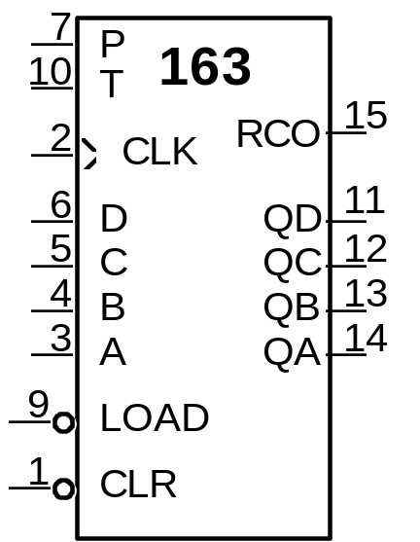
Kinds of Registers and Counters
A common 4-bit counter
Synchronous Load and Clear Inputs
Positive Edge Triggered FFs
Parallel Load Data from D, C, B, A
P, T Enable Inputs: both must be asserted to
enable counting
RCO: asserted when counter enters its highest
state 1111, used for cascading counters
"Ripple Carry Output"
74163 Synchronous
4-Bit Upcounter
74161: similar in function, asynchronous load and reset
CSE 307: Digital Technique
Page <number>

Slide 25
Kinds of Registers and Counters
Ring Counter
+V
+V
+V
End-Around
1
\Reset
4 possible states, single bit change per state, useful for avoiding glitches
Must be initialized
0
J
S
Q
Q
1
J
S
Q
Q
2
J
S
Q
Q
3
J
S
Q
Q
4
CLK
CLK
CLK
CLK
K
R
Q
K
R
Q
K
R
Q
K
R
Q
Shift
V+
100
Shift
Q1
Q2
Q3
Q4
1
0
0
0
0
1
0
0
0
0
1
0
0
0
0
1
1
0
0
0
0
1
0
0
0
0
1
0
0
0
0
1
1
0
0
0
CSE 307: Digital Technique
Page <number>

Slide 26
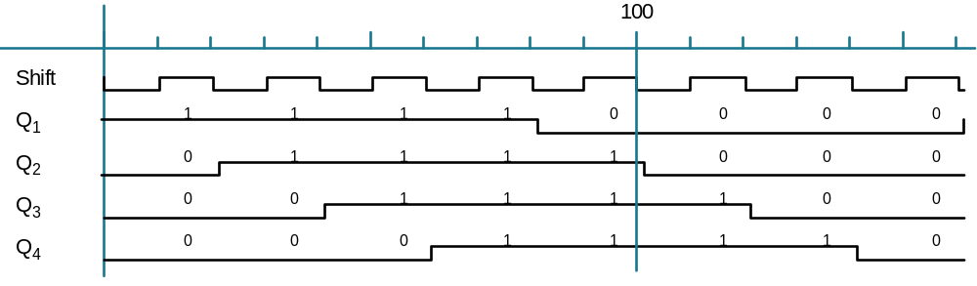
Kinds of Registers and Counters
Twisted Ring (Johnson, Mobius) Counter
+V
+V
+V
Inverted
End-Around
1
\Reset
0
S
Q
S
Q
S
Q
S
Q
8 possible states, single bit change per state, useful for avoiding glitches
J
Q
1
J
Q
2
J
Q
3
J
Q
4
CLK
CLK
CLK
CLK
K
R
Q
K
R
Q
K
R
Q
K
R
Q
Shift
+V
CSE 307: Digital Technique
Page <number>

Slide 27
Counter Design Procedure
Introduction
The process is a special case of the general sequential circuit design procedure.
no decisions on state assignment or transitions
current state is the output
Example:
3-bit Binary Upcounter
Decide to implement with
Toggle Flipflops
What inputs must be
presented to the T FFs
to get them to change
to the desired state bit?
We need to use the T FF excitation table to translate the present/next state values to FF inputs
000
111
Present
state
Next
state
0
0
0
0
1
1
1
1
0
0
1
1
0
0
1
1
0
1
0
1
0
1
0
1
0
0
0
1
1
1
1
0
0
1
1
0
0
1
1
0
1
0
1
0
1
0
1
0
001
110
010
101
011
100
CSE 307: Digital Technique
Page <number>

Slide 28
Self-Starting Counters
Start-Up States
At power-up, counter may be in any possible state
Designer must guarantee that it (eventually) enters a valid state
Especially a problem for counters that validly use a subset of states
Self-Starting Solution:
Design counter so that even the invalid states
eventually transition to valid state
S6
S5
S0
S4
S0
S4
S1
S3
S1
S3
S5
S2
S7
S6
S2
S7
Two Self-Starting State Transition Diagrams
CSE 307: Digital Technique
Page <number>

Slide 29
Implementation with Different Kinds of FFs
D FFs are easiest to use for implementation; no translation is needed from state transitions to FF inputs
  FF next state value IS the FF input value
T, SR, JK FFs need an extra step in the design procedure
  We start with the transition; pairs of present state, next state values
  What we need to find is what FF input values are needed that result in the defined transitions
This information is the FF EXCITATION TABLE
  Derived from the FF characteristic table
  Defines inputs needed for all four possible PS/NS combinations
CSE 307: Digital Technique
Page <number>

Slide 30
Implementation with Different Kinds of FFs
Derivation of JK Excitation Table
Characteristic Table
Excitation Table
J
0
0
0
0
1
1
1
1
K
0
0
1
1
0
0
1
1
Q(t)
0
1
0
1
0
1
0
1
Q(t+)
0
1
0
0
1
1
1
0
Q(t)
0
0
1
1
Q(t+)
0
1
0
1
J
K
Look for rows in the characteristic table that have the same Q(t), Q(t+)
values; observe what the J,K inputs are for those cases
CSE 307: Digital Technique
Page <number>

Slide 31
Implementation with Different Kinds of FFs
Derivation of JK Excitation Table
Characteristic Table
Excitation Table
J
0
0
0
0
1
1
1
1
K
0
0
1
1
0
0
1
1
Q(t)
0
1
0
1
0
1
0
1
Q(t+)
0
1
0
0
1
1
1
0
Q(t)
0
0
1
1
Q(t+)
0
1
0
1
J
K
For the two 0,0 cases, J is constant 0, K is 0 in one case, 1 in the other.
Therefore for the 0,0 transition, J must be 0, K is a don’t care.
CSE 307: Digital Technique
Page <number>

Slide 32
Implementation with Different Kinds of FFs
Derivation of JK Excitation Table
Characteristic Table
Excitation Table
J
0
0
0
0
1
1
1
1
K
0
0
1
1
0
0
1
1
Q(t)
0
1
0
1
0
1
0
1
Q(t+)
0
1
0
0
1
1
1
0
Q(t)
0
0
1
1
Q(t+)
0
1
0
1
J
0
K
X
The necessary J,K values are then entered in the excitation table
CSE 307: Digital Technique
Page <number>

Slide 33
Implementation with Different Kinds of FFs
Derivation of JK Excitation Table
Characteristic Table
Excitation Table
J
0
0
0
0
1
1
1
1
K
0
0
1
1
0
0
1
1
Q(t)
0
1
0
1
0
1
0
1
Q(t+)
0
1
0
0
1
1
1
0
Q(t)
0
0
1
1
Q(t+)
0
1
0
1
J
0
1
X
X
K
X
X
1
0
CSE 307: Digital Technique
Page <number>

Slide 34
Implementation with Different Kinds of FFs
Exication tables for D, T, SR, JK flip-flops
Excitation Tables
Q(t)
0
0
1
1
Q(t+)
0
1
0
1
D
0
1
0
1
T
0
1
1
0
S
0
1
0
X
R
X
0
1
0
J
0
1
X
X
K
X
X
1
0
CSE 307: Digital Technique
Page <number>

Slide 35
Implementation with Different Kinds of FFs
Translation from State Transition to FF Inputs
The determination of the FF input values now becomes:
1. For each present state/next state transition value pair
2. Look up the FF inputs needed in the excitation table
3. Enter the values in the FF input true table
We’ll use a T FF for Qa, an SR FF for Qb, and a JK FF for QC
Qa
0
0
0
0
1
1
1
1
Qb
0
0
1
1
0
0
1
1
Qc
0
1
0
1
0
1
0
1
Qa+
0
0
0
1
1
1
1
0
Qb+
0
1
1
0
0
1
1
0
Qc+
1
0
1
0
1
0
1
0
Ta
0
0
0
0
1
1
1
1
Sb
0
0
0
0
1
1
1
1
Rb
0
0
0
0
1
1
1
1
Jc
0
0
0
0
1
1
1
1
Kc
0
0
0
0
1
1
1
1
CSE 307: Digital Technique
Page <number>

Slide 36
Implementation with Different Kinds of FFs
FF Inputs for T, SR, JK FFs
3 bit binary counter
Q(t)
0
0
1
1
Q(t+)
0
1
0
1
D
0
1
0
1
T
0
1
1
0
S
0
1
0
X
R
X
0
1
0
J
0
1
X
X
K
X
X
1
0
Qa
0
0
0
0
1
1
1
1
Qb
0
0
1
1
0
0
1
1
Qc
0
1
0
1
0
1
0
1
Qa+
0
0
0
1
1
1
1
0
Qb+
0
1
1
0
0
1
1
0
Qc+
1
0
1
0
1
0
1
0
Ta
0
1
0
0
1
0
1
1
Sb
0
1
X
0
1
1
X
0
Rb
X
0
0
1
X
0
0
1
Jc
1
X
1
X
1
X
1
X
Kc
X
1
X
1
X
1
X
1
CSE 307: Digital Technique
Page <number>

Slide 37
Implementation with Different FF Types
Comparison
• T FFs well suited for straightforward binary counters
But yielded worst gate and literal count for this example!
• No reason to choose R-S over J-K FFs: it is a proper subset of J-K
R-S FFs don't really exist anyway
J-K FFs yielded lowest gate count
Tend to yield best choice for packaged logic where gate count is key
• D FFs yield simplest design procedure
Best literal count
D storage devices very transistor efficient in VLSI
Best choice where area/literal count is the key
CSE 307: Digital Technique
Page <number>

Slide 38
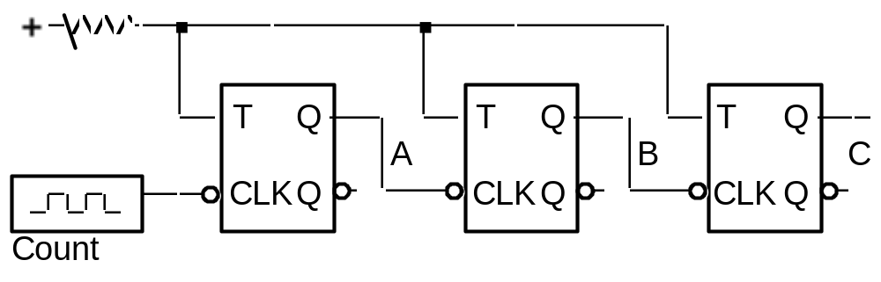
Asynchronous vs. Synchronous Counters
Ripple Counters
Deceptively attractive alternative to synchronous design style
Count signal ripples from left to right
State transitions are not sharp!
Can lead to "spiked outputs" from combinational logic
decoding the counter's state
CSE 307: Digital Technique
Page <number>

Slide 39
Ripple Counters (Up or Down)
Three characteristics determine if a ripple counter counts up or down
  FF clock input polarity
  FF output to clock polarity
  Counter output polarity
A ripple counter with negative clock polarity, Q to next FF clock, and Q counter outputs counts UP
Change an odd number of characteristics and the counter counts DOWN
CSE 307: Digital Technique
Page <number>

Slide 40

























Cascaded Counters
Cascaded Synchronous Counters with Ripple Carry Outputs
First stage RCO enables second stage for counting
RCO asserted
soon after stage
enters state 1111
also a function
of the T Enable
Downstream stages
lag in their 1111 to
0000 transitions
Affects Count period
and decoding logic
ET
EP
ET
EP
RCO
RCO
A
B
C
D
QA
QB
QC
QD
A
B
C
D
QA
QB
QC
QD
LD
LD
CLR
CLR
CSE 307: Digital Technique
Page <number>

Slide 41
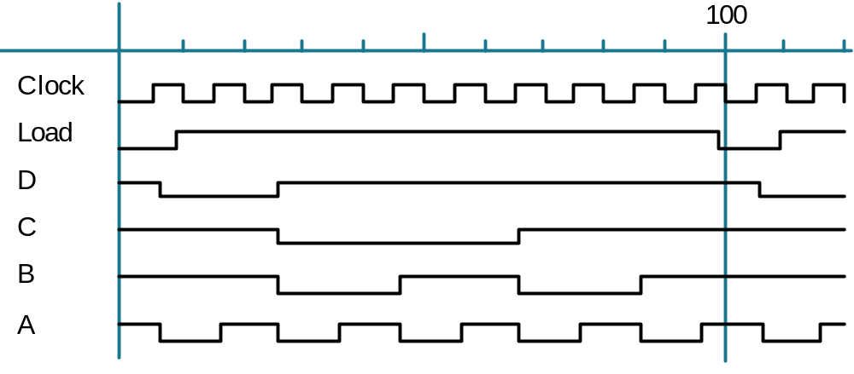




Other Counter Sequences
The Power of Synchronous Clear and Load
Starting Offset Counters:
e.g., 0110, 0111, 1000, 1001, 1010, 1011, 1100, 1101, 1110, 1111, 0110, ...
D C B A
R
Q
Q
Q
Q
1
C
D
C
B
A
L
6
O
C
O
C
3
L
A
L
P
T
K
D C B A
D
R
+
+
Load
0
1
0110
is the state
to be loaded
Use RCO signal to trigger Load of a new state
Since 74163 Load is synchronous, state changes
only on the next rising clock edge
CSE 307: Digital Technique
Page <number>

